Slide 1
Microservices architecture
Notes:
Information in this document, including URL and other Internet Web site references, is subject to change without notice. Unless otherwise noted, the example companies, organizations, products, domain names, e-mail addresses, logos, people, places, and events depicted herein are fictitious, and no association with any real company, organization, product, domain name, e-mail address, logo, person, place or event is intended or should be inferred. Complying with all applicable copyright laws is the responsibility of the user. Without limiting the rights under copyright, no part of this document may be reproduced, stored in or introduced into a retrieval system, or transmitted in any form or by any means (electronic, mechanical, photocopying, recording, or otherwise), or for any purpose, without the express written permission of Microsoft Corporation.
Microsoft may have patents, patent applications, trademarks, copyrights, or other intellectual property rights covering subject matter in this document. Except as expressly provided in any written license agreement from Microsoft, the furnishing of this document does not give you any license to these patents, trademarks, copyrights, or other intellectual property.
The names of manufacturers, products, or URLs are provided for informational purposes only and Microsoft makes no representations and warranties, either expressed, implied, or statutory, regarding these manufacturers or the use of the products with any Microsoft technologies. The inclusion of a manufacturer or product does not imply endorsement of Microsoft of the manufacturer or product. Links may be provided to third party sites. Such sites are not under the control of Microsoft and Microsoft is not responsible for the contents of any linked site or any link contained in a linked site, or any changes or updates to such sites. Microsoft is not responsible for webcasting or any other form of transmission received from any linked site. Microsoft is providing these links to you only as a convenience, and the inclusion of any link does not imply endorsement of Microsoft of the site or the products contained therein.
© 2017 Microsoft Corporation. All rights reserved.
Microsoft and the trademarks listed at https://www.microsoft.com/en-us/legal/intellectualproperty/Trademarks/Usage/General.aspx are trademarks of the Microsoft group of companies. All other trademarks are property of their respective owners.

Slide 2
Abstract and learning objectives
Abstract
In this whiteboard design session, you will work in a group to design a solution that leverages aspects from microservices and serverless architectures to help an online concert ticket vendor survive the first five minutes of crushing load. You will handle the client's scaling needs through microservices built on top of Service Fabric and apply smooth updates or roll back failing updates. Finally, your group will design an implementation of load testing to optimize the architecture for handling spikes in traffic.
Learning objectives
Implement scale and resiliency with Service Fabric
Enable serverless solutions with Azure Functions
Control API access with API Management
Provide query flexibility with Cosmos DB
Notes:
This is an introduction to the Cloud Workshop at a high level. Later we’ll get into customer objections, requirements, etc… but we want to ground the participants on the business outcomes we’re going after for the day.

Slide 3
Step 1: Review the customer case study
Outcome
Analyze your customer needs
Timeframe
15 minutes

Slide 4
Customer situation
Contoso Events is an online ticket provider experiencing consistent growth
Has plans to further growth demand
Wants to extend customer reach through partners
Plans to retire and replace existing customer solution
Notes:
Contoso Events is an online service provider for concerts, sporting and other large event ticket sales.
Contoso Events has experienced consistent growth trends
Has marketing and partner engagement plans to further grow demand.
They plan to extend customer reach through partners by exposing its core event ticket sales and reporting APIs to partners.
They plan to retire and replace their existing solution in order to serve customers with a better experience – preserving code where possible.
The current Contoso Events solution consists of a collection of web sites implemented in ASP.NET
SQL Server back-end
Hosted by Azure on Virtual Machines (VMs)

Slide 5


Customer situation
Concerned about performance, scale, and costs
Desire a decoupled design
Interested in microservices, Service Fabric, and serverless architectures
Looking for strategy for exposing APIs to partners
Notes:
They are concerned about performance, scale and costs as they grow.
Must be able to handle significant increases in demand during peak periods – such as when a popular event has tickets first go on sale.
They want to meet the demand of peak traffic periods while conserving costs during non-peak periods.
They will create mobile apps for iPhone, Android and Windows Phone devices.
They would like to investigate options for optimizing hosting and related operational costs.
They want to migrate to a decoupled design with improved business agility
They have challenges rolling out new features and supporting new events on demand. The code base has many interdependencies and this increases the risk of regressions across features when changes are introduced.
The ticket ordering process is a pain point as the data model for new events is often slightly different – which means that supporting new events may have impact on the user experience and UI, the middle tier and storage.
Rolling out changes that impact this area while upwards of 50,000 users are actively placing orders, has proven to be a fragile process and requires them to schedule down time to ensure safe deployment.
The CIO has heard about microservices, and is interested in exploring how Service Fabric, Azure Functions and supporting Azure features may help the team:
Increase agility in their development cycle
Decrease impact across features
Support continuous delivery
Keep operations lean
Keep costs contained during peak loads
In addition, they want a solid strategy for exposing APIs to partners in a secure and manageable way

Slide 6

Customer needs
Event tickets can be orders from multiple channels
Customers must be registered/logged in to place orders
Admin site for order management and reports
Ability to rapidly release new features, while reducing downtime
Reduce downtime caused by system updates
Notes:
Event tickets can be ordered from multiple channels: the web site, new mobile applications, and third-party site and applications via available APIs.
Customers must be registered / logged in to place orders, so that they can login and find their orders, and for reporting and analytics purposes.
Internal staff will manage orders and view reports from the Admin site.
The ability to rapidly release new features that may involve UI, business logic and data model changes. Reduce dependency across features.
Reduced overall downtime caused by system updates. Rollouts must be possible without scheduled downtime. Rollbacks must be possible in the event of failure.

Slide 7
Customer needs
Be able to handle unpredictable spikes in demand
Improved operations management
Migrate to Cosmos DB
Secure API management
Integration with third-party credit card processor
Notes:
The solution must be able to handle increased system load for ticket purchasing including higher peak periods without excessive increases in management overhead and cost.
Operations management overhead must be improved through better system monitoring, visibility, self-healing services and auto-scale features.
The customer has decided to migrate from SQL Server to Cosmos DB for a more flexible schema and increased scalability across features.
A solution for securing and managing APIs used internally and by external partners with ability to easily publish, version, onboard consumers, control policy, monitor and audit usage.
The solution currently processes credit cards with a third party payment-processing provider. This aspect of the solution will remain the same but require integration into the new design.

Slide 8



Customer objections
Is Service Fabric the right solution?
Which of our existing skills can be applied to microservices and Service Fabric?
Can stateful services or actors help us with ticket ordering throughput?
How and where can stateful services and actors help us?
How can Azure Functions be leveraged?
Notes:
While we are interested in the microservices approach, we are still comparing Service Fabric with PaaS features such as App Services and SQL DB. Service Fabric seems relatively new, while App Services and SQL DB have been around for some time.
Microservices architectures are completely new to the Contoso Events team. If we were to go forward with Service Fabric, we would like to understand what skills the team can carry forward, and how much of a learning curve exists.
We’d like to understand if stateful services or stateful actors will help us with ticket ordering throughput, workflow and state management, and easier rollouts of changes to this process.
We are not clear how and where to incorporate stateful services and actors alongside other storage such as Cosmos DB. We need the ability to support robust ad-hoc queries against our system data such as events, customers, orders and related metrics – but would like to take advantage of the performance and reliability of Service Fabric stateful options as well.
Could we consider Azure Functions as an alternative back end implementation for our APIs?

Slide 9
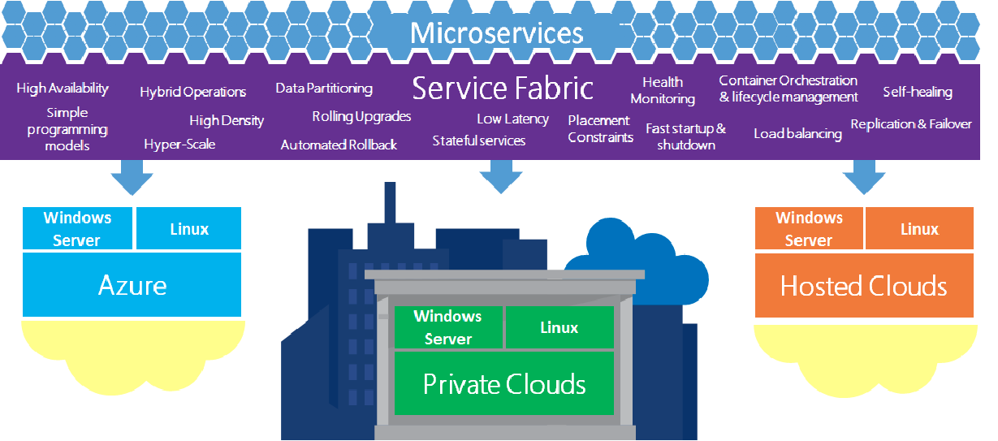
Common scenarios
Service Fabric overview
Notes:
This diagram represents a Service Fabric overview for this type of scenario, from which you can draw inspiration. You will find this diagram within the Whiteboard Design Session Student Guide.

Slide 10
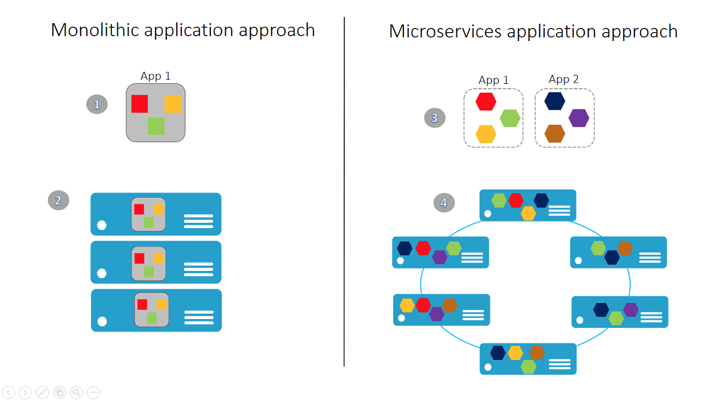
Common scenarios
Monolithic vs. Microservices approach
Notes:
This diagram presents a comparison of monolithic versus microservices approaches for this type of scenario, from which you can draw inspiration. You will find this diagram within the Whiteboard Design Session Student Guide.

Slide 11
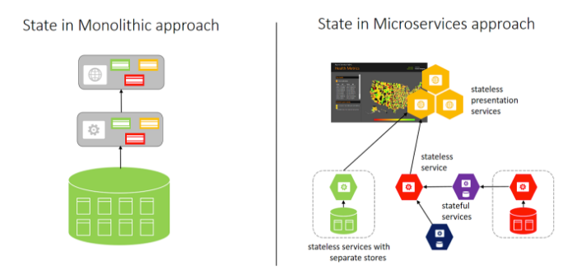
Common scenarios
Monolithic vs. Microservices – storage state
Notes:
This diagram presents a comparison of State storage in monolithic versus microservices approaches, from which you can draw inspiration. You will find this diagram within the Whiteboard Design Session Student Guide.

Slide 12
Step 2: Design the solution
Outcome
Design a solution and prepare to present the solution to the target customer audience in a 15-minute chalk-talk format.
Timeframe
60 minutes
Business needs (15 minutes) | Respond to questions outlined in your guide and list the answers on a flipchart
Design (35 minutes) | Design a solution for as many of the stated requirements as time allows. Show the solution on a flipchart.
Prepare (15 minutes) | Identify any customer needs that are not addressed with the proposed solution Identify the benefits of your solution Determine how you will respond to the customer’s objections Prepare for a 15-minute presentation to the customer

Slide 13
Step 3: Present the solution
Outcome
Present a solution to the target customer in a 15-minute chalk-talk format
Timeframe
30 minutes (15 minutes for each team to present and receive feedback)
Directions
Pair with another table
One table is the Microsoft team and the other table is the customer
The Microsoft team presents their proposed solution to the customer
The customer asks one of the objections from the list of objections in the case study
The Microsoft team responds to the objection
The customer team gives feedback to the Microsoft team

Slide 14
Wrap-up
Outcome
Identify the preferred solution for the case study
Identify solutions designed by other teams
Timeframe
15 minutes

Slide 15

Preferred target audience
Steve Dormer, CIO at Contoso Events
Primary audience is business and technology decision makers
Usually talk to key architects, developers, and Infrastructure Managers who report to the CIO, or to application sponsors or their representatives
Notes:
Steve Dormer, CIO at Contoso Events
The primary audience is the technical strategic decision-maker with influential solution architects, or lead technical personnel in development or operations. For this example this could include the CIO and his core team.
Usually we talk to the key architects, developers and infrastructure managers who report to the CIO, or to key solution sponsors or those that represent the business unit IT or developers that report to those sponsors.

Slide 16
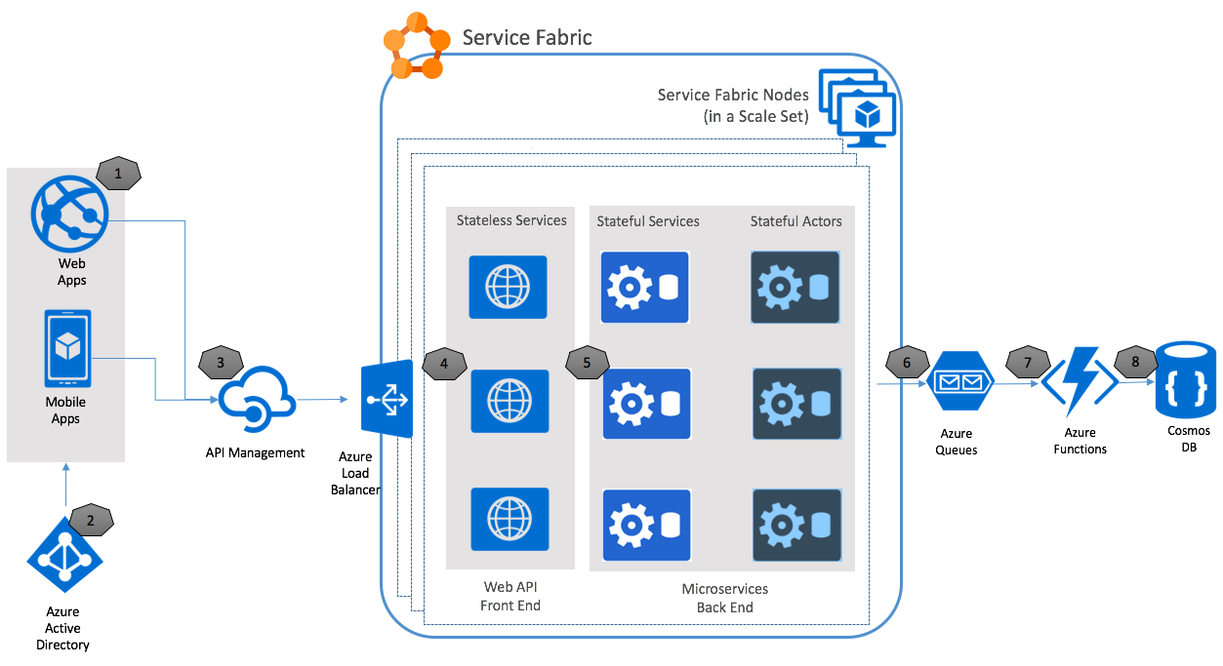
Preferred solution
Notes:
This preferred solution is just one of many viable options
From a high-level:
Starting with #1 on the left, Contoso Events will have both web and mobile applications that consume the back-end APIs for the solution.
Users will authenticate to applications using tokens issued by Azure AD B2C.
We will use an API Management layer as a gateway to all HTTP Web APIs exposed by the solution. It will be configured to authorize tokens issued by trusted Azure B2C tenants. This can be expanded to additional token issuers for third parties in future.
Requests to HTTP Web APIs at the front end will go through Azure Load Balancer and distribute across the available Service Fabric nodes in the cluster.
We will implement Business functionality through stateful services and actors, which will be called by Web APIs. These compose the microservices back end, which will sync their data back to the Cosmos DB instance for ad-hoc queries, by writing the jobs to an Azure queue.
An Azure Function will handle processing the queue and updating the TicketOrders and related collections in Cosmos DB, according to business rules.

Slide 17
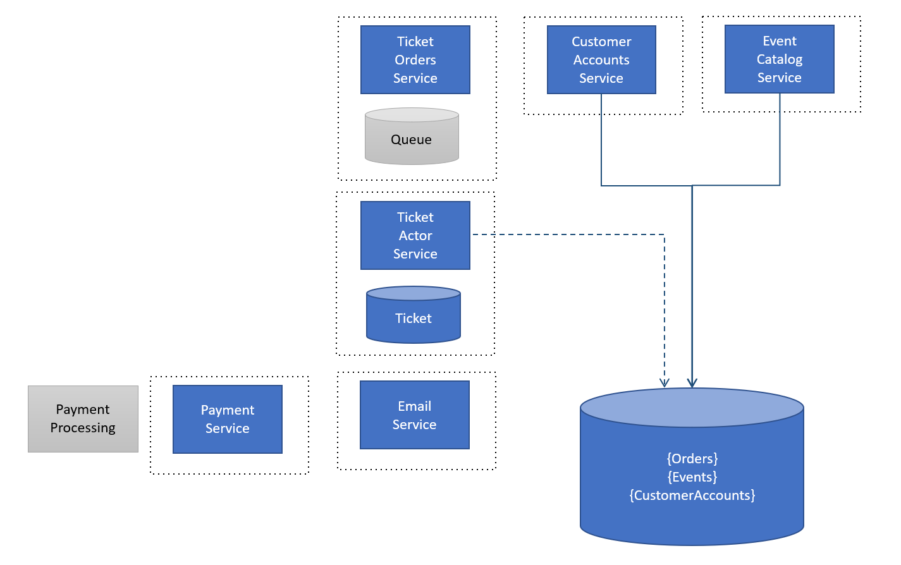
Preferred solution
Notes:
Here is a high-level architecture of the core services that compose the new microservices architecture, as well as the state they hold.
The Ticket Orders Service, on top of the diagram, will take advantage of reliable queues provided by Service Fabric to persist requests.
The Ticket Actor Service processes orders in the queue, and represents a single instance of an order and its processing workflow and state.
When an order is processed, the state is externalized for shared read only services to support aggregation across other data and to optimize reads.

Slide 18
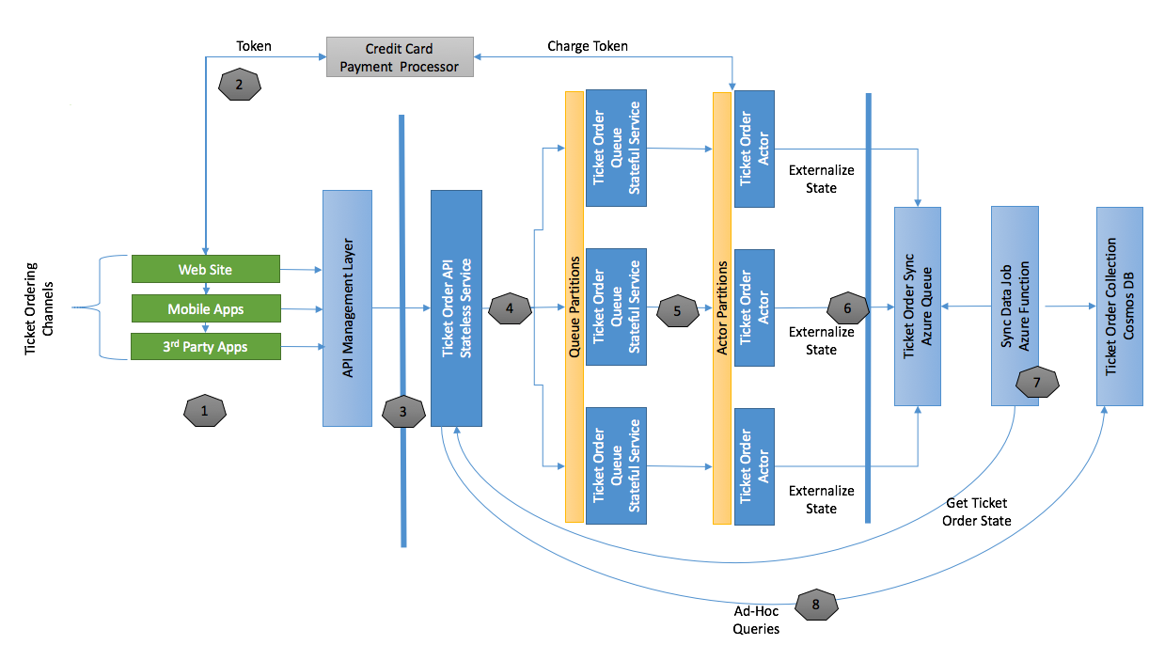
Preferred solution
Scalability of ticket orders
Notes:
Illustrate in more detail the Service Fabric services and components participating in a ticket ordering request.
This diagram illustrates the Service Fabric services and components participating in a ticket ordering request.
The left-hand side of the diagram shows the various ticket ordering channels, such as the Contoso Events consumer web site and mobile applications, as well as third parties who build applications that place ticket orders.
Following the numbered steps, the UI will pre-flight the credit card charge from the order page and supply the resulting token to the back-end processing of the order.
All ticket order requests will call the Ticket Order API through the API Management layer, which will queue the request for processing, passing the token for credit card validation, order details, and any other information required to complete the request asynchronously.
The Ticket Order Queue stateful service will process these requests by instantiating a Ticket Order Actor to handle the processing workflow. This actor is responsible for charging the credit card, finalizing the order, and notifying the customer to give them access to their order.
The actor will also write to a Ticket Order Sync queue to offload sending order data to Cosmos DB for reports, analytics, and related ad-hoc queries.
An Azure Function will read from the queue and handle updates to Cosmos DB. In order to ensure the latest data is always persisted, the function will retrieve the latest order state and update the Cosmos DB Ticket Orders collection.
Web APIs will expose data from Cosmos DB for additional ad-hoc queries against ticket orders.

Slide 19
Preferred solution
Scalability of ticket orders
API Management used to meet demand and high-availability requirements
Ticker Order API offloads requests to Ticket Order Queue using Service Fabric
Ticket Order Actor handles processing
Azure Function persists orders in Cosmos DB
Notes:
Describe the scalability features of this design, including any partitioning strategies that are applicable.
API Management Premium features support scaling and multi-region topologies to meet demand and high availability requirements.
The stateless Ticket Order API offloads valid requests to the stateful Ticket Order Queue. This queue is partitioned by instance count so that requests can be distributed by Service Fabric to the appropriate node or service instance according to availability to process the message.
The stateful Ticket Order Queue is partitioned by instance count (from 1 to n).
When the stateless Ticket Order API offloads valid requests to this queue, those requests are randomly distributed by Service Fabric across these partitions, removing the bottleneck of writes to the queue, thanks to parallel distribution.
The stateful Ticket Order Actor handles processing from this queue and given the number of parallel orders helps the solution to scale by maintaining the state of any number of parallel orders.
The actor is partitioned by order id, which allows for very fine-grained distribution of state, per order, across the cluster.
Millions of these can exist and distribute across the cluster and inactive actors are evicted from memory automatically to conserve resources.
Describe the resiliency of this use case. How can you create an asynchronous ticket order request and guarantee processing? Are there any potential points of failure? How will you address those?
Web applications will not report success unless the Payment Processing succeeds and the order is successfully queued. The queue does not report successful receipt of the message until a quorum is reached.
All Web API calls go through API Management, which can be scaled within a region, or deployed to multiple regions.
The Ticket Order Actor does not remove the order from the queue unless it can successfully process its workflow and save to the Order Sync Queue.
The Azure Function that processes the Order Sync Queue removes messages from the queue if processing is successful to Cosmos DB.
Any of these messages that can’t be processed are moved to a poison queue, to be retried or processed again through another mechanism.
For additional visibility into queue / function processing errors it is good practice to monitor queue sizes that pass a reasonable threshold of standard solution behavior.
Describe how you will enable external clients to reach stateless HTTP services exposed from the Azure load balancer.
When you publish a stateless HTTP service the Service Fabric provides a relative URL to the service according to the configuration you supply.
This way, multiple HTTP services can be deployed to a single node and still be uniquely addressable at port 80 or 443.
In the case of this solution, the API Management layer will consume those endpoints and forward requests.

Slide 20

Preferred solution
Improving DevOps workflows
Visual Studio Service Fabric solution
Upgrade application to preserve state
Service Fabric performance counters drive auto-scaling
Service Fabric inherently provides HA
Notes:
How would you structure the Visual Studio solution so that developers can run, debug and publish the entire solution, but also be able to publish and upgrade individual microservices (could be one or more service grouped together)?
A typical Service Fabric solution has a top-level application that can be used to publish all services associated with it. To publish the entire suite of services in a solution you can add all services to this top-level application.
You can create additional Service Fabric applications in the solution that isolate specific services for deployment.
Describe to the customer how they can upgrade services in situ and preserve state; handle rollback and roll forward; and service self-healing features.
When an application is deployed, you can choose to “upgrade” the application. This preserves any state associated with stateful services if applicable. This will retire previous versions once they complete requests in process, while sending new requests to the new version of the service.
If during the upgrade process there is a problem with the services being deployed, the upgrade is rolled back and the previous version of the services continue to operate.
If the Service Fabric runtime detects any service instances are no longer operational, new instances of the service are initialized to maintain the required minimum instances for the service.
Explain how the Service Fabric cluster handles auto-scaling. How does Service Fabric help the customer to make better utilization of their compute resources?
Currently, performance counters emitted by the Service Fabric cluster drive auto-scaling. You can set up a base requirement for minimum nodes in the cluster (based on reliability level chosen) and configure auto-scale rules to scale up or down within that range, as the available nodes in the cluster become fully or less utilized.
When you deploy services, they are distributed across the available nodes in the Service Fabric cluster – including replicas for stateful services. Service Fabric will ensure that services are distributed across nodes according to any placement constraints, while ensuring that nodes are densely populated.
How would you plan for high availability (HA) for Service Fabric in this solution?
Service Fabric inherently provides high availability within the cluster region.
You achieve multi-region high availability for disaster recovery scenarios by using the backup/restore capability of stateful services.
You can also create real time high availability across regions by configuring Traffic Manager to route traffic to both regions. In this case, any stateful services should be capable of reloading their latest state from external storage if not present in the region’s cluster.

Slide 21
Preferred solution
Improving DevOps workflows
Problems and failures reported in Service Fabric health manager
Cluster security provisioned up front
Service Fabric updates handled by Microsoft
Notes:
Explain to the customer how Service Fabric can help the customer have visibility into overall solution health.
If you report problems and failures to the Azure Service Fabric health manager from your service code, you can use standard health monitoring tools that Service Fabric provides to check the health status.
For example, you can report configuration errors that would prevent the solution from reliable operation, and report these as exceptions to the Service Fabric.
Exceptions that are detected while the Service Fabric tries to perform upgrades will trigger a rollback operation to avoid introducing this failure into the system.
How can you update cluster settings after the fact? What kind of settings might you want to update?
You cannot change the security of the cluster after provisioning it, so it is important to set the cluster up as a secure cluster, from the beginning.
You may need to modify the ARM template you used to create the cluster, add new ports you want to expose, add new node types for scale tiers, and then re-apply the template to safely upgrade the cluster nodes.
How will you keep your cluster up to date with the latest Service Fabric SDK?
Microsoft updates the runtime SDK on all clusters, unless the cluster is in an unhealthy state. You do not have to update the cluster yourself to keep it current.

Slide 22

Preferred solution
Controlling Access to APIs
API publishing tools and Swagger
Leverage API Management features
All API consumers issued a key
Employ Azure AD B2C for customer login
Notes:
Describe how API Management may be useful to control access to APIs exposed by the solution.
Initially the solution will benefit from API publishing tools and swagger, API security policy and token validation and internal applications that can be created as pre-assigned API consumers without a sophisticated setup.
Eventually, as the partner ecosystem is built out, the customer will want to leverage many more API Management features such as API consumer onboarding and policy management, API consumer self-service features such via the consumer portal, blog, API documentation, incident reporting tools and API consumer throttling and usage metrics reporting.
How would you identify the user and the API consumer or application?
All consumers, including internal applications, will be issued a consumer key.
The solution will employ Azure Active Directory B2C for customer login, and will use the same mechanism for API security. API Management policy will be set up to authorize access only to callers with a signed Azure AD token (JWT) issued by the solution tenant, for consumer applications. Corporate applications may introduce another Azure AD tenant that syncs with their internal AD, for example.

Slide 23
Preferred objections handling
Is Service Fabric the right solution?
Service Fabric has been battle tested for many years prior to becoming generally available. In fact, Service Fabric is the underlying foundation for Azure’s own SQL DB and Cosmos DB services among other high traffic applications such as the very popular Halo game.
As for choosing between Service Fabric and App Services or SQL DB the benefits of the former include:
The ability to deploy individual application services without concern over the target infrastructure – let Service Fabric decide the target nodes appropriate for each tier and service type
Simplified approach to managing data persistence with stateful services
Microservices design from the ground up on a platform that is specifically designed for that purpose – with the ability to scale
Notes:
While we are interested in the microservices approach, we are still comparing Service Fabric with PaaS features such as App Services and SQL DB. How mature is Service Fabric by comparison?
Service Fabric has been battle tested for many years prior to becoming generally available. In fact, Service Fabric is the underlying foundation for Azure’s own SQL DB and Cosmos DB services among other high traffic applications such as the very popular Halo game.
As for choosing between Service Fabric and App Services or SQL DB the benefits of the former include:
The ability to deploy individual application services without concern over the target infrastructure – let Service Fabric decide the target nodes appropriate for each tier and service type.
Simplified approach to managing data persistence with stateful services.
Microservices design from the ground up on a platform that is specifically designed for that purpose – with the ability to scale.
Microservices architectures are completely new to the Contoso Events team. If we were to go forward with Service Fabric, we would like to understand what skills the team can carry forward, and how much of a learning curve exists.
Service Fabric is a natural transition for .NET developers in many respects:
They can continue to use Visual Studio for development, debugging and publishing applications
They can leverage Service Fabric project templates to kick-start their understanding of Service Fabric services.
The programming model for services is familiar.
Working with stateful services is also familiar in the sense that state is defined via objects (POCO) and serialized as part of the service implementation.
We’d like to understand if stateful services or stateful actors will help us with ticket ordering throughput, workflow and state management, and easier rollouts of changes to this process.
Stateful services are backed by robust and reliable storage. When data (state) is saved by the service, it is not confirmed (committed) unless a quorum is reached.
By using the stateful actor, not only is the persistence of the actual ticket order handled by the Service Fabric at scale, but the actor can be wholly responsible for the workflow required to complete the order
When updates to this actor are required, the existing state is preserved, any active instances can continue completing their work, and the new actor functionality or state requirements can be rolled out safely across the nodes in the cluster, eventually retiring the previous version.
We are not clear how and where to incorporate stateful services and actors alongside other storage such as Cosmos DB. We need the ability to support robust ad-hoc queries against our system data such as events, customers, orders and related metrics – but would like to take advantage of the performance and reliability of Service Fabric stateful options as well.
Stateful services make it easy to save and retrieve state, and distribute that state for higher availability by using a partitioning strategy. Each partition has its own replica set for reliability.
You can replicate this state to an external store like Cosmos DB to support ad-hoc querying, analytics and disaster recovery.
Could we consider Azure Functions as an alternative back end implementation for our APIs?
While it is possible to create functions that run behind API Management endpoints, they are best employed for decoupled, asynchronous background operations that can be run at scale without concern for the specific server running that operation.
In this solution, Azure Functions allowed for decoupling the external storage location of orders, without the need to update Service Fabric configurations on change. It also allowed for a separate scale-out tier for that work.
In a solution such as a mobile application back end, functions could be useful if they don’t need to comingle with other solution aspects – such as acting as their own microservice with a targeted purpose.

Slide 24
Preferred objections handling
Which of our existing skills can be applied to microservices and Service Fabric?
Service Fabric is a natural transition for .NET developers in many respects:
They can continue to use Visual Studio for development, debugging and publishing applications
They can leverage Service Fabric project templates to kick-start their understanding of Service Fabric services
The programming model for services is familiar
Working with stateful services is also familiar in the sense that state is defined via objects (POCO) and serialized as part of the service implementation
Notes:
While we are interested in the microservices approach, we are still comparing Service Fabric with PaaS features such as App Services and SQL DB. How mature is Service Fabric by comparison?
Service Fabric has been battle tested for many years prior to becoming generally available. In fact, Service Fabric is the underlying foundation for Azure’s own SQL DB and Cosmos DB services among other high traffic applications such as the very popular Halo game.
As for choosing between Service Fabric and App Services or SQL DB the benefits of the former include:
The ability to deploy individual application services without concern over the target infrastructure – let Service Fabric decide the target nodes appropriate for each tier and service type.
Simplified approach to managing data persistence with stateful services.
Microservices design from the ground up on a platform that is specifically designed for that purpose – with the ability to scale.
Microservices architectures are completely new to the Contoso Events team. If we were to go forward with Service Fabric, we would like to understand what skills the team can carry forward, and how much of a learning curve exists.
Service Fabric is a natural transition for .NET developers in many respects:
They can continue to use Visual Studio for development, debugging and publishing applications
They can leverage Service Fabric project templates to kick-start their understanding of Service Fabric services.
The programming model for services is familiar.
Working with stateful services is also familiar in the sense that state is defined via objects (POCO) and serialized as part of the service implementation.
We’d like to understand if stateful services or stateful actors will help us with ticket ordering throughput, workflow and state management, and easier rollouts of changes to this process.
Stateful services are backed by robust and reliable storage. When data (state) is saved by the service, it is not confirmed (committed) unless a quorum is reached.
By using the stateful actor, not only is the persistence of the actual ticket order handled by the Service Fabric at scale, but the actor can be wholly responsible for the workflow required to complete the order
When updates to this actor are required, the existing state is preserved, any active instances can continue completing their work, and the new actor functionality or state requirements can be rolled out safely across the nodes in the cluster, eventually retiring the previous version.
We are not clear how and where to incorporate stateful services and actors alongside other storage such as Cosmos DB. We need the ability to support robust ad-hoc queries against our system data such as events, customers, orders and related metrics – but would like to take advantage of the performance and reliability of Service Fabric stateful options as well.
Stateful services make it easy to save and retrieve state, and distribute that state for higher availability by using a partitioning strategy. Each partition has its own replica set for reliability.
You can replicate this state to an external store like Cosmos DB to support ad-hoc querying, analytics and disaster recovery.
Could we consider Azure Functions as an alternative back end implementation for our APIs?
While it is possible to create functions that run behind API Management endpoints, they are best employed for decoupled, asynchronous background operations that can be run at scale without concern for the specific server running that operation.
In this solution, Azure Functions allowed for decoupling the external storage location of orders, without the need to update Service Fabric configurations on change. It also allowed for a separate scale-out tier for that work.
In a solution such as a mobile application back end, functions could be useful if they don’t need to comingle with other solution aspects – such as acting as their own microservice with a targeted purpose.

Slide 25
Preferred objections handling
Can stateful services or actors help us with ticket ordering throughput?
Stateful services are backed by robust and reliable storage. When data (state) is saved by the service, it is not confirmed (committed) unless a quorum is reached.
By using the stateful actor, not only is the persistence of the actual ticket order handled by the Service Fabric at scale, but the actor can be wholly responsible for the workflow required to complete the order
When updates to this actor are required, the existing state is preserved, any active instances can continue completing their work, and the new actor functionality or state requirements can be rolled out safely across the nodes in the cluster, eventually retiring the previous version
Notes:
While we are interested in the microservices approach, we are still comparing Service Fabric with PaaS features such as App Services and SQL DB. How mature is Service Fabric by comparison?
Service Fabric has been battle tested for many years prior to becoming generally available. In fact, Service Fabric is the underlying foundation for Azure’s own SQL DB and Cosmos DB services among other high traffic applications such as the very popular Halo game.
As for choosing between Service Fabric and App Services or SQL DB the benefits of the former include:
The ability to deploy individual application services without concern over the target infrastructure – let Service Fabric decide the target nodes appropriate for each tier and service type.
Simplified approach to managing data persistence with stateful services.
Microservices design from the ground up on a platform that is specifically designed for that purpose – with the ability to scale.
Microservices architectures are completely new to the Contoso Events team. If we were to go forward with Service Fabric, we would like to understand what skills the team can carry forward, and how much of a learning curve exists.
Service Fabric is a natural transition for .NET developers in many respects:
They can continue to use Visual Studio for development, debugging and publishing applications
They can leverage Service Fabric project templates to kick-start their understanding of Service Fabric services.
The programming model for services is familiar.
Working with stateful services is also familiar in the sense that state is defined via objects (POCO) and serialized as part of the service implementation.
We’d like to understand if stateful services or stateful actors will help us with ticket ordering throughput, workflow and state management, and easier rollouts of changes to this process.
Stateful services are backed by robust and reliable storage. When data (state) is saved by the service, it is not confirmed (committed) unless a quorum is reached.
By using the stateful actor, not only is the persistence of the actual ticket order handled by the Service Fabric at scale, but the actor can be wholly responsible for the workflow required to complete the order
When updates to this actor are required, the existing state is preserved, any active instances can continue completing their work, and the new actor functionality or state requirements can be rolled out safely across the nodes in the cluster, eventually retiring the previous version.
We are not clear how and where to incorporate stateful services and actors alongside other storage such as Cosmos DB. We need the ability to support robust ad-hoc queries against our system data such as events, customers, orders and related metrics – but would like to take advantage of the performance and reliability of Service Fabric stateful options as well.
Stateful services make it easy to save and retrieve state, and distribute that state for higher availability by using a partitioning strategy. Each partition has its own replica set for reliability.
You can replicate this state to an external store like Cosmos DB to support ad-hoc querying, analytics and disaster recovery.
Could we consider Azure Functions as an alternative back end implementation for our APIs?
While it is possible to create functions that run behind API Management endpoints, they are best employed for decoupled, asynchronous background operations that can be run at scale without concern for the specific server running that operation.
In this solution, Azure Functions allowed for decoupling the external storage location of orders, without the need to update Service Fabric configurations on change. It also allowed for a separate scale-out tier for that work.
In a solution such as a mobile application back end, functions could be useful if they don’t need to comingle with other solution aspects – such as acting as their own microservice with a targeted purpose.

Slide 26
Preferred objections handling
How and where can stateful services and actors help us?
Stateful services make it easy to save and retrieve state, and distribute that state for higher availability by using a partitioning strategy. Each partition has its own replica set for reliability.
You can replicate this state to an external store like Cosmos DB to support ad-hoc querying, analytics and disaster recovery
Notes:
While we are interested in the microservices approach, we are still comparing Service Fabric with PaaS features such as App Services and SQL DB. How mature is Service Fabric by comparison?
Service Fabric has been battle tested for many years prior to becoming generally available. In fact, Service Fabric is the underlying foundation for Azure’s own SQL DB and Cosmos DB services among other high traffic applications such as the very popular Halo game.
As for choosing between Service Fabric and App Services or SQL DB the benefits of the former include:
The ability to deploy individual application services without concern over the target infrastructure – let Service Fabric decide the target nodes appropriate for each tier and service type.
Simplified approach to managing data persistence with stateful services.
Microservices design from the ground up on a platform that is specifically designed for that purpose – with the ability to scale.
Microservices architectures are completely new to the Contoso Events team. If we were to go forward with Service Fabric, we would like to understand what skills the team can carry forward, and how much of a learning curve exists.
Service Fabric is a natural transition for .NET developers in many respects:
They can continue to use Visual Studio for development, debugging and publishing applications
They can leverage Service Fabric project templates to kick-start their understanding of Service Fabric services.
The programming model for services is familiar.
Working with stateful services is also familiar in the sense that state is defined via objects (POCO) and serialized as part of the service implementation.
We’d like to understand if stateful services or stateful actors will help us with ticket ordering throughput, workflow and state management, and easier rollouts of changes to this process.
Stateful services are backed by robust and reliable storage. When data (state) is saved by the service, it is not confirmed (committed) unless a quorum is reached.
By using the stateful actor, not only is the persistence of the actual ticket order handled by the Service Fabric at scale, but the actor can be wholly responsible for the workflow required to complete the order
When updates to this actor are required, the existing state is preserved, any active instances can continue completing their work, and the new actor functionality or state requirements can be rolled out safely across the nodes in the cluster, eventually retiring the previous version.
We are not clear how and where to incorporate stateful services and actors alongside other storage such as Cosmos DB. We need the ability to support robust ad-hoc queries against our system data such as events, customers, orders and related metrics – but would like to take advantage of the performance and reliability of Service Fabric stateful options as well.
Stateful services make it easy to save and retrieve state, and distribute that state for higher availability by using a partitioning strategy. Each partition has its own replica set for reliability.
You can replicate this state to an external store like Cosmos DB to support ad-hoc querying, analytics and disaster recovery.
Could we consider Azure Functions as an alternative back end implementation for our APIs?
While it is possible to create functions that run behind API Management endpoints, they are best employed for decoupled, asynchronous background operations that can be run at scale without concern for the specific server running that operation.
In this solution, Azure Functions allowed for decoupling the external storage location of orders, without the need to update Service Fabric configurations on change. It also allowed for a separate scale-out tier for that work.
In a solution such as a mobile application back end, functions could be useful if they don’t need to comingle with other solution aspects – such as acting as their own microservice with a targeted purpose.

Slide 27
Preferred objections handling
How can Azure Functions be leveraged?
While it is possible to create functions that run behind API Management endpoints, they are best employed for decoupled, asynchronous background operations that can be run at scale without concern for the specific server running that operation
In this solution, Azure Functions allowed for decoupling the external storage location of orders, without the need to update Service Fabric configurations on change. It also allowed for a separate scale-out tier for that work.
In a solution such as a mobile application back end, functions could be useful if they don’t need to comingle with other solution aspects – such as acting as their own microservice with a targeted purpose
Notes:
While we are interested in the microservices approach, we are still comparing Service Fabric with PaaS features such as App Services and SQL DB. How mature is Service Fabric by comparison?
Service Fabric has been battle tested for many years prior to becoming generally available. In fact, Service Fabric is the underlying foundation for Azure’s own SQL DB and Cosmos DB services among other high traffic applications such as the very popular Halo game.
As for choosing between Service Fabric and App Services or SQL DB the benefits of the former include:
The ability to deploy individual application services without concern over the target infrastructure – let Service Fabric decide the target nodes appropriate for each tier and service type.
Simplified approach to managing data persistence with stateful services.
Microservices design from the ground up on a platform that is specifically designed for that purpose – with the ability to scale.
Microservices architectures are completely new to the Contoso Events team. If we were to go forward with Service Fabric, we would like to understand what skills the team can carry forward, and how much of a learning curve exists.
Service Fabric is a natural transition for .NET developers in many respects:
They can continue to use Visual Studio for development, debugging and publishing applications
They can leverage Service Fabric project templates to kick-start their understanding of Service Fabric services.
The programming model for services is familiar.
Working with stateful services is also familiar in the sense that state is defined via objects (POCO) and serialized as part of the service implementation.
We’d like to understand if stateful services or stateful actors will help us with ticket ordering throughput, workflow and state management, and easier rollouts of changes to this process.
Stateful services are backed by robust and reliable storage. When data (state) is saved by the service, it is not confirmed (committed) unless a quorum is reached.
By using the stateful actor, not only is the persistence of the actual ticket order handled by the Service Fabric at scale, but the actor can be wholly responsible for the workflow required to complete the order
When updates to this actor are required, the existing state is preserved, any active instances can continue completing their work, and the new actor functionality or state requirements can be rolled out safely across the nodes in the cluster, eventually retiring the previous version.
We are not clear how and where to incorporate stateful services and actors alongside other storage such as Cosmos DB. We need the ability to support robust ad-hoc queries against our system data such as events, customers, orders and related metrics – but would like to take advantage of the performance and reliability of Service Fabric stateful options as well.
Stateful services make it easy to save and retrieve state, and distribute that state for higher availability by using a partitioning strategy. Each partition has its own replica set for reliability.
You can replicate this state to an external store like Cosmos DB to support ad-hoc querying, analytics and disaster recovery.
Could we consider Azure Functions as an alternative back end implementation for our APIs?
While it is possible to create functions that run behind API Management endpoints, they are best employed for decoupled, asynchronous background operations that can be run at scale without concern for the specific server running that operation.
In this solution, Azure Functions allowed for decoupling the external storage location of orders, without the need to update Service Fabric configurations on change. It also allowed for a separate scale-out tier for that work.
In a solution such as a mobile application back end, functions could be useful if they don’t need to comingle with other solution aspects – such as acting as their own microservice with a targeted purpose.

Slide 28
Customer quote
“With Service Fabric we are able to move to microservices architecture without the DevOps headache. Service Fabric provides so much to support deployment, compute utilization, health monitoring and recovery – we could leverage the same team while increasing the size of our solution and feature set!”
—Steve Dormer, CIO at Contoso Events

